Slide 1
Risk Analysis Management
CSE 307 Project Management and Strategy
Bidita Sarkar Diba
Lecturer
Department of Computer Science & Engineering
University of Asia Pacific Bangladesh

Slide 2
Project Risk Management
The process of identifying, assessing, and mitigating risks that could impact a project’s success.
Key Objectives:
Minimize negative impacts of risks.
Enhance opportunities for project success.
Ensure project objectives are met within scope, time, and budget.

Slide 3
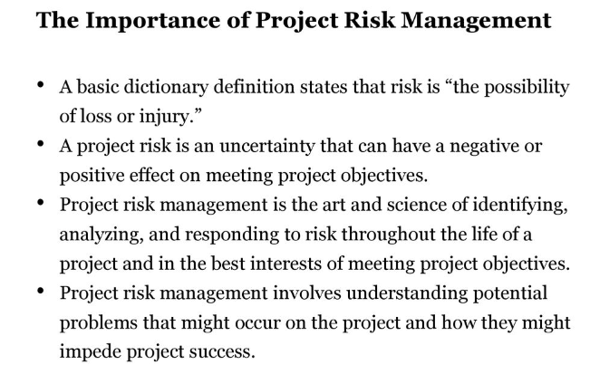
Importance of Project Risk Management

Slide 4
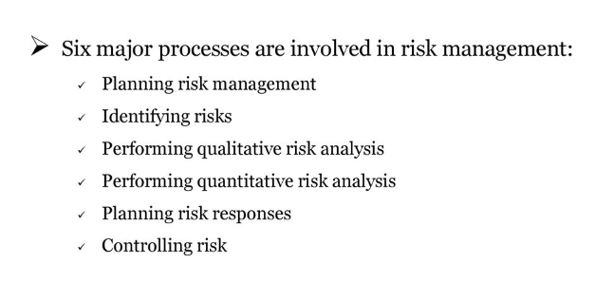
Process of Project Risk Management

Slide 5
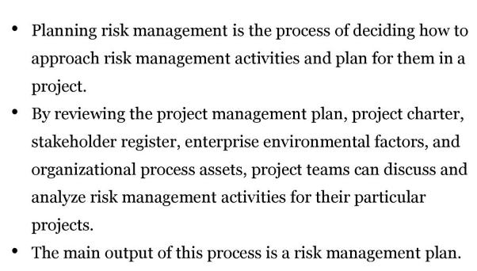
Planning Risk Management

Slide 6
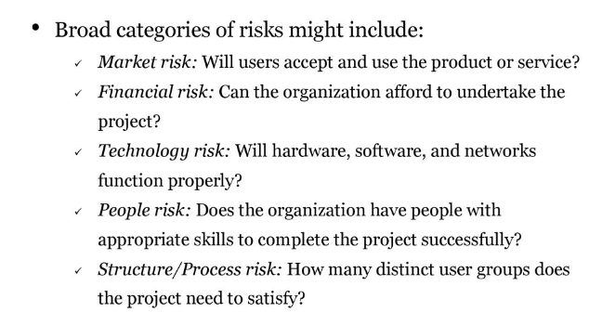
Planning Risk Management (Cont.)

Slide 7
Identifying Project Risk:
Project risk is an uncertain event or condition that, if it occurs, has a positive or negative effect on one or more project objectives. Through risk management you try to increase probability and impact of opportunities, while decrease probability and impact of threats.
Uncertainty: Lack of knowledge that reduce confidence in conclusions
Risk Averse: Someone who doesn’t want to take risks.
Risk Tolerance: Area of acceptable risks
Thresholds: The point at which risk becomes unacceptable.

Slide 8
Identifying Project Risk:
Risk Factors:
Probability : How much percent risk may occur
Impact: Range of possible outcomes (Time – Money)
Timing: When the risk is expected to take place
Frequency: How often this risk is expected to happen

Slide 9
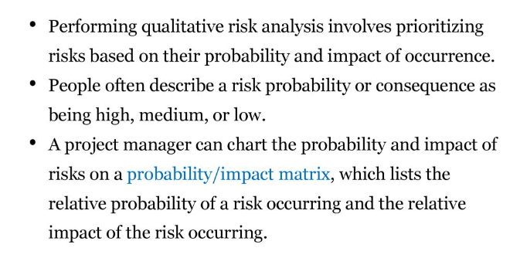
Performing Qualitative Risk Analysis

Slide 10
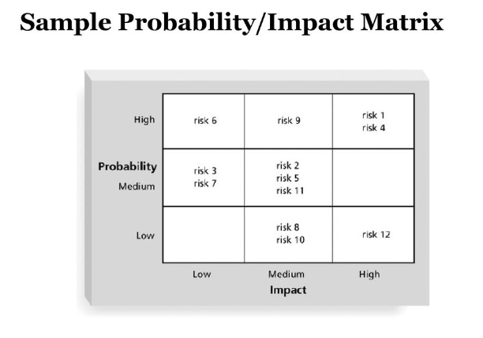
Performing Qualitative Risk Analysis
Qualitative analysis of risk serves 3 functions:
Priorities risks according to probability & impact
Identify the main areas of risk exposure
Improve understanding of project risks (Senior, Self, Team Member)

Slide 11
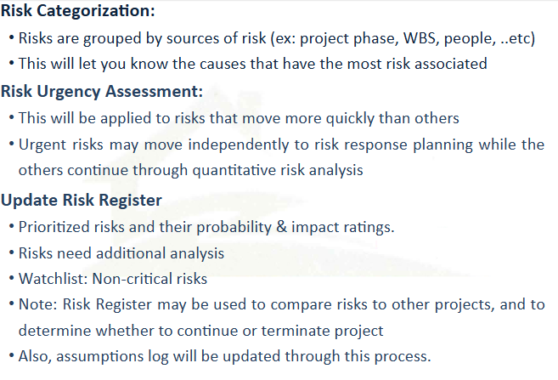
Performing Qualitative Risk Analysis

Slide 12
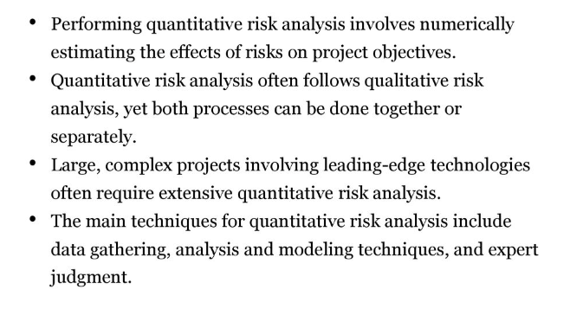
Performing Quantitative Risk Analysis

Slide 13
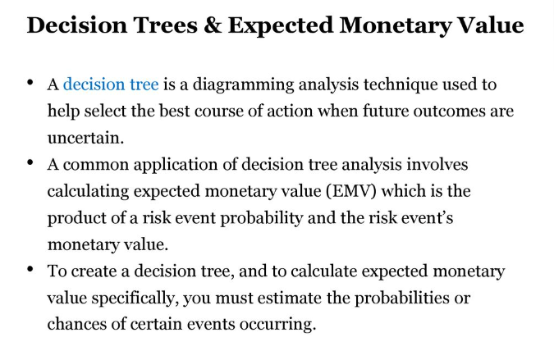
Performing Quantitative Risk Analysis

Slide 14
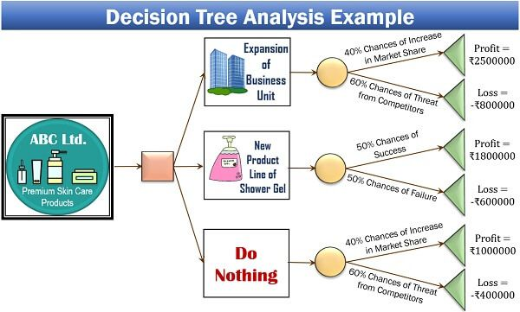
Performing Quantitative Risk Analysis

Slide 15
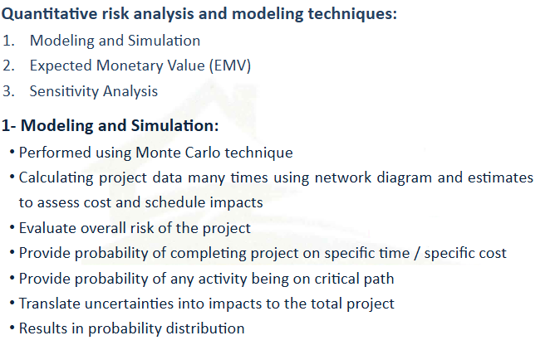
Performing Quantitative Risk Analysis

Slide 16
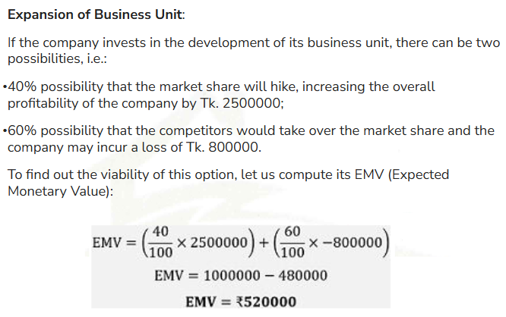
Performing Quantitative Risk Analysis

Slide 17
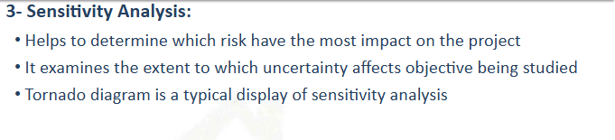
Performing Quantitative Risk Analysis
Base |  | Units | Labor Cost | Material Cost | Total Cost | Result
 |  | 250 Units | $ 30 | $ 50 | $ 20’000 | - | -
Quantity Change | Scenario (1-1) Increase 50 Units | 300 Units | $ 30 | $ 50 | $24’000 | + 20 % | Lower Limit
 | Scenario (1-2) Decrease 30 Units | 220 Units | $ 30 | $ 50 | $ 17’600 | - 12 % | Upper Limit
Labor Cost Change | Scenario (2-1) Labor cost $ 40 | 250 Units | $ 40 | $ 50 | $ 22’500 | +12.5 % | Lower Limit
 | Scenario (2-2) Labor cost $ 25 | 250 Units | $ 25 | $ 50 | $ 18’750 | - 6.25 % | Upper Limit

Slide 18
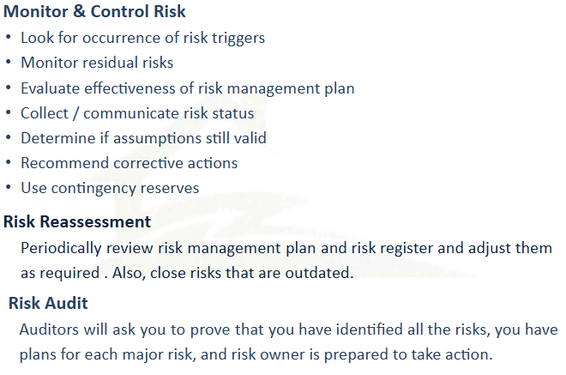
Controlling Risks

Slide 19
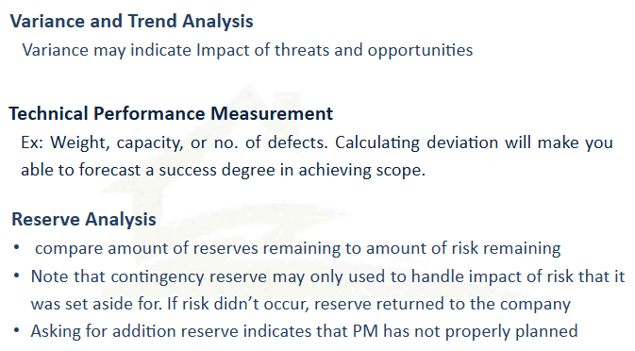
Controlling Risks

Slide 20
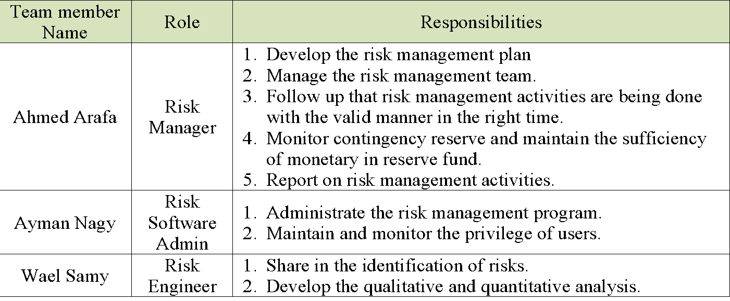
Sample Risk Management Plan:

Slide 21
Sample Risk Management Plan:
Activity | 2014 |  |  |  |  |  |  |  | 2015
 | Aug |  | Sep |  | Oct |  | Nov | Dec | Jan | Feb | Mar
Risk Plan
Risks Identification
Risk Assessment
Response Plan

Slide 22
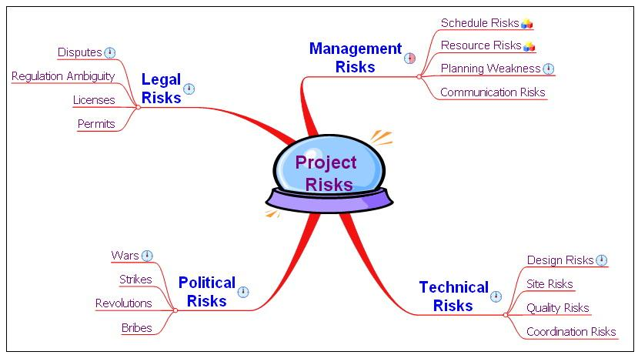
Category Of Risk:

Slide 23
Thank You

